Slide 1
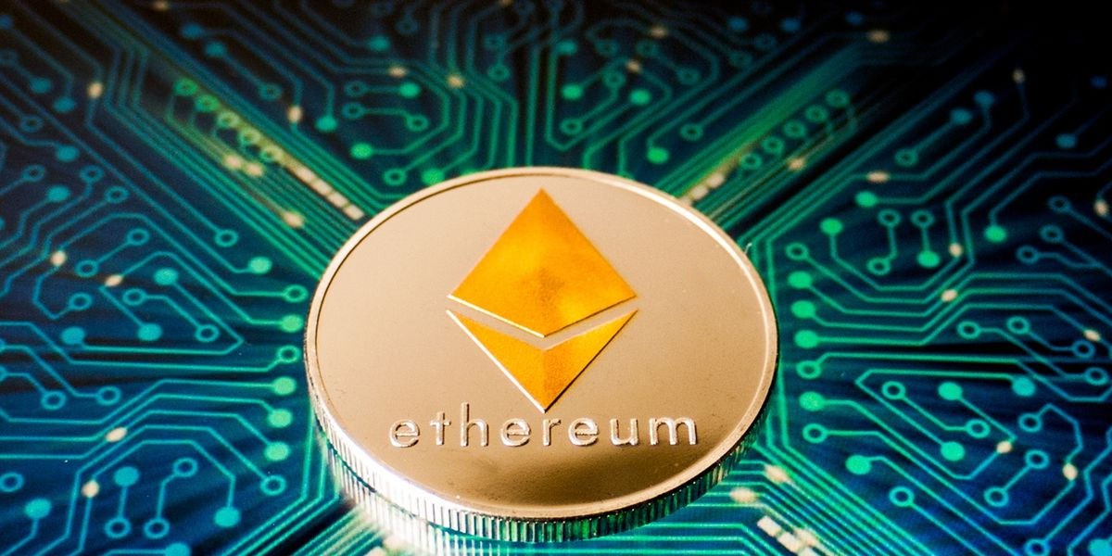
Ethereum And Deep Learning
Project students: Asala Ahmad Hadeel Rayan 207731746 Supervisor: Roi Bar-Zur Main Supervisor: Hovav Gazit Lap : NSSL

Slide 2
Agenda:
Project description
Ethereum Information
Blockchain and selfish mining
Previous project
MDP model
Actions and transitions in our model
Results
Comparing to previous papers

Slide 3
In This project :
In this model we analyze the selfish mining strategies in Ethereum, and we study the threshold size by implementing an MDP model following the previous works that have studied Ethereum and Bitcoin. Our addition in this paper that we consider the whale transaction that the miner receives an additional reward called Fees for the transaction included in the block (by making changes to the giving MDP and modifying parameters)
We will use the model of the mining process of a Nakamoto based blockchain with varying fees
And the model WeRLman model for finding near optimal strategies in blockchain

Slide 4

Blockchain
The blockchain records the transactions in units of blocks
Blockchains are maintained by miners , who receive rewards (virtual tokens) for creating blocks containing user-generated transactions, each block rewards its creator with newly minted tokens (virtual tokens) and with transaction fees paid by the users, in addition to the nephew and uncle rewards, special reward on Ethereum.

Slide 5
Selfish mining
Due to the nature of mining process, the interval between mining events exhibits high variance from the point of view of a single miner. Consequently, miners typically organize themselves into mining pools. All the members of a bool work together to mine each block, and later they share their revenue when one of them successfully mines a block.
The attacker miner can withhold its newly mined blocks and publish them strategically to maximize its own revenue.
The pool keeps its newly discovered blocks private, creating a fork on purpose. The pool then continues to mine on the private branch, while the honest miners still mine on public branches
When the public approaches the pool’s private chain in length, and the pool choose to broadcast their private chain, this leads honest miners to waste resources on mining cryptographic puzzles that end up serving no purpose.

Slide 6
A little about Ethereum

Slide 9
Previous project about Ethereum

Slide 10
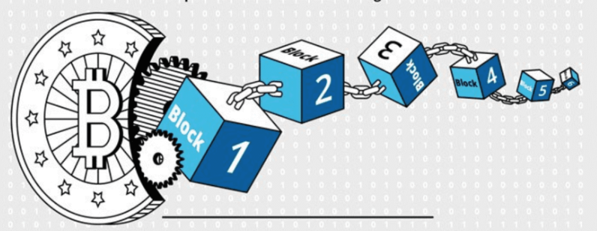
Previous project about Bitcoin considering whale transactions

Slide 11

Our MDP :
S : state space $( \vec{a} ,\vec{ h} , fork,r,u_{a},\vec{u_{h}},Pool)$
A: action space
$Adopt l$
$Override l$
$Match$
$Wait f$
$Reveal$

Slide 12
MDP simplifying

